Slide 1
Imagine a tollbooth at a bridge. Cars passing by the booth are expected to pay a 50 cent toll. Mostly they do, but sometimes a car goes by without paying. The tollbooth keeps track of the number of cars that have gone by, and of the total amount of money collected.

Slide 2
In this railway reservation system, users can get both the train details and the train reservation details. The details to be provided for train are train no., train name, boarding point, destination point, no. of seats in first class and fare per ticket, no. of seats in second class and fare per ticket and date of travel.

Slide 3
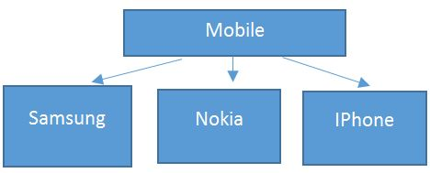
When we take a mobile as an object, its basic functionality for which it was invented were Calling & Receiving a call & Messaging. But now a days thousands of new features & models were added & the count is still increasing.
In above diagram, each brand (Samsung, Nokia, IPhone) have their own list of features along with basic functionality of dialing, receiving a call & messaging.
When we talk about OOP, as the word indicate it will talk about an object (a real world object)

Slide 4
object
Any real world entity which can have some characteristics or which can perform some work is called as Object. This object is also called as an instance i.e. - a copy of entity in programming language. If we consider the above example, a mobile manufacturing company, at a time manufactures lacs of pieces of each model which are actually an instance. This objects are differentiated from each other via some identity or its characteristics. This characteristics is given some unique name.
Mobile mbl1 = new Mobile ();
Mobile mbl2 = new Mobile ();

Slide 5
class
A Class is a plan which describes the object. We call it as a blue print of how the object should be represented. Mainly a class would consist of a name, attributes & operations. Considering the above example, A Mobile can be a class which has some attributes like Profile Type, IMEI Number, Processor, and some more.) & operations like Dial, Receive & SendMessage.

Slide 6
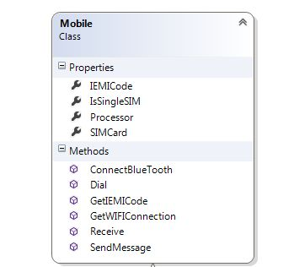

Slide 7
Classes
A class is a way to bind the data & its associated functions together.
It allows the data & function to be hidden ,if necessary ,from external use.
Generally a class specification has two parts :
1.Class Declaration – it describes the type & scope of its members.
2.Class function definition – it describes how the class function are implemented.

Slide 8
Declaring a class
The general form of a class declaration is-
Class class_name
{
private:
variable declaration; // data members or class members
function declaration;
public :
variable declaration; // Member functions
function declaration;
};

Slide 9
Classes in C++
A class definition begins with the keyword class.
The body of the class is contained within a set of braces, { } ; (notice the semi-colon).
class class_name
{
….
….
….
};
Any valid identifier
Class body (data member + methods)

Slide 10
Classes in C++
Within the body, the keywords private: and public: specify the access level of the members of the class.
the default is private.
Usually, the data members of a class are declared in the private: section of the class and the member functions are in public: section.
Notes:
10

Slide 11
Classes in C++
class class_name
{
private:
…
…
…
public:
…
…
…
};
private members or methods
Public members or methods

Slide 12
Classes in C++
Member access specifiers
public:
can be accessed outside the class directly.
The public stuff is the interface.
private:
Accessible only to member functions of class
Private members and methods are for internal use only.

Slide 14
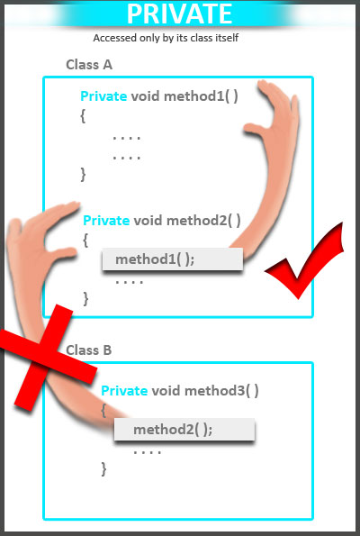

Slide 15
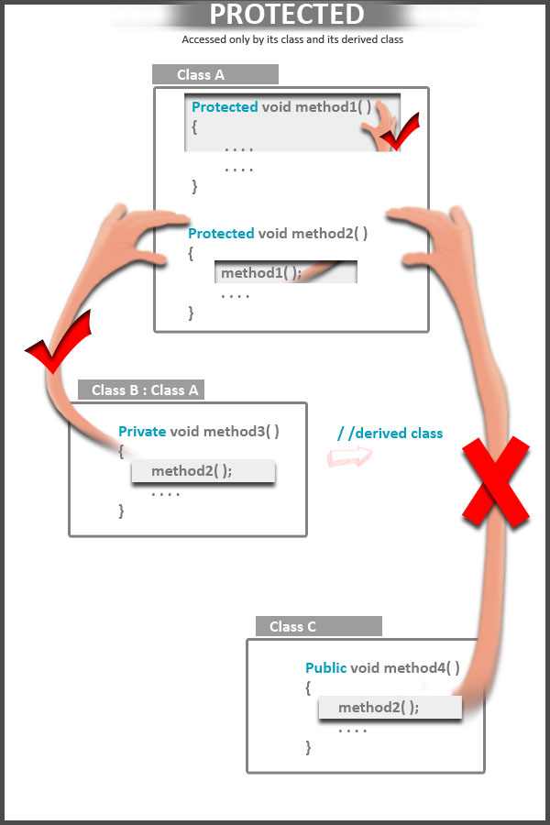

Slide 16
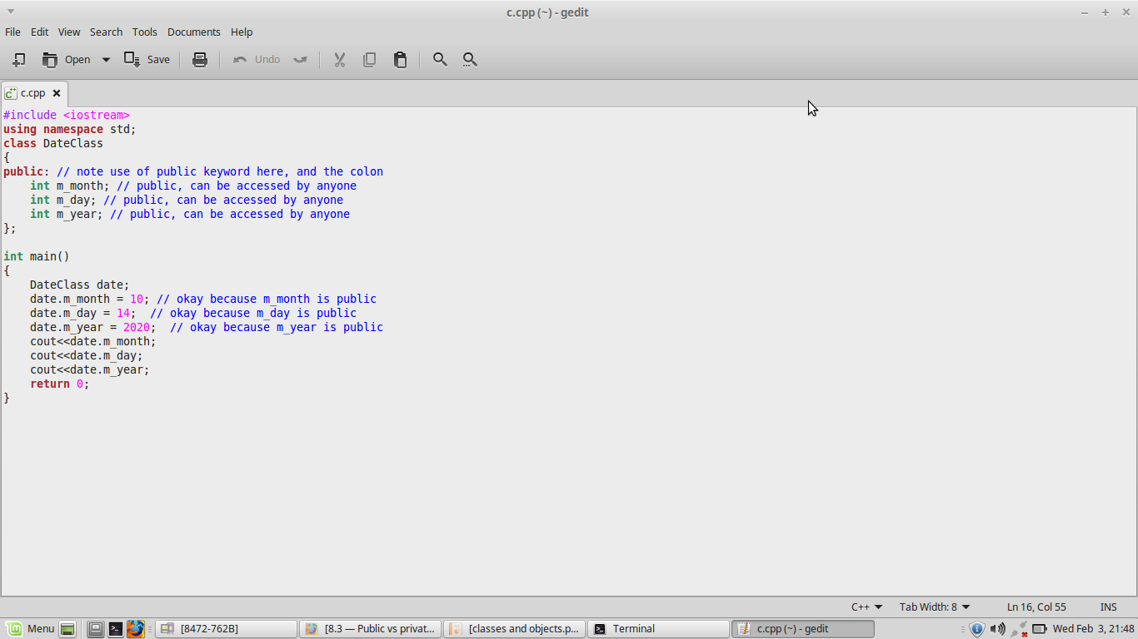
Access specifiers

Slide 17
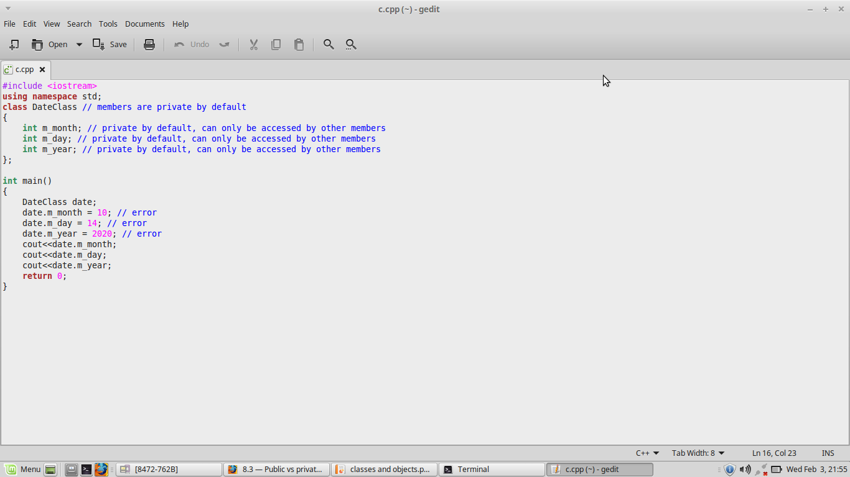
Access specifiers

Slide 18
Class Example
This class example shows how we can encapsulate (gather) a circle information into one package (unit or class)
No need for others classes to access and retrieve its value directly. The
class methods are responsible for
that only.
class Circle
{
private:
double radius;
public:
void setRadius(double r); double getDiameter();
double getArea();
double getCircumference();
};
They are accessible from outside
the class, and they can access the
member (radius)

Slide 19
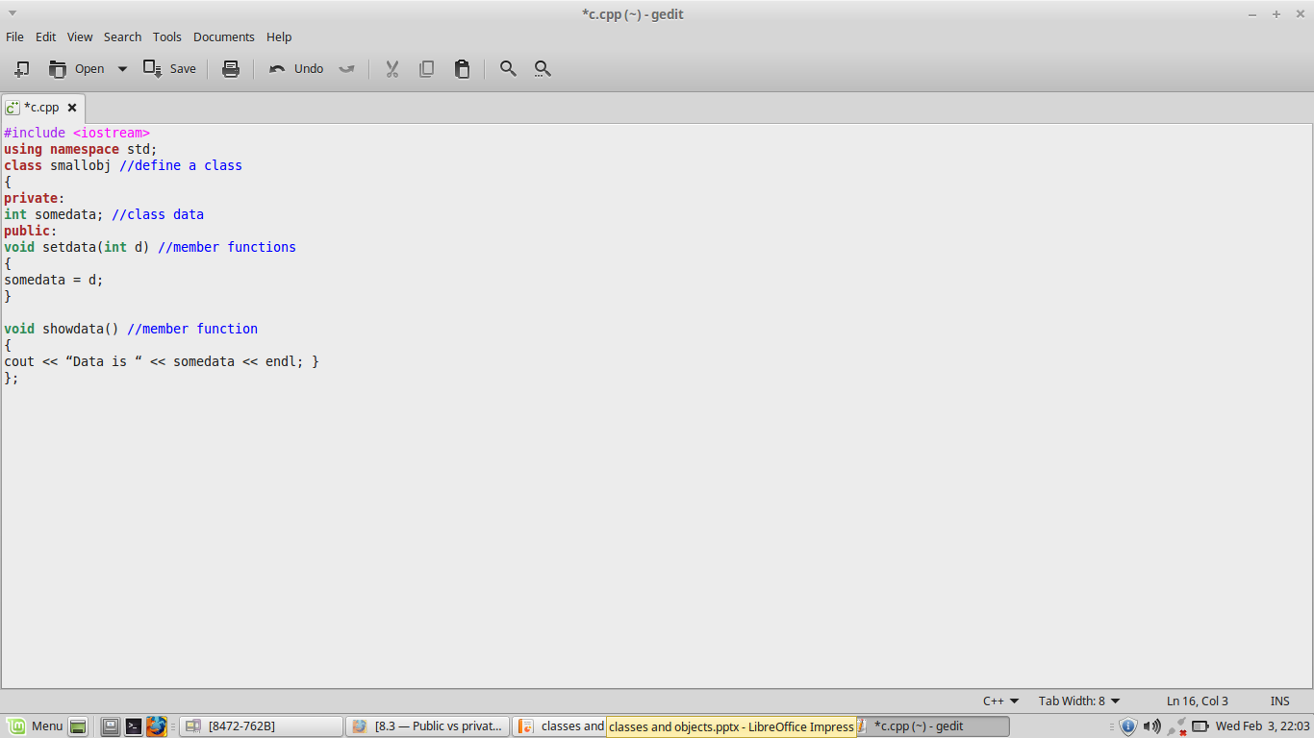
Defining the Class
test
somedata
setdata)(d)
showdata()
50
50

Slide 20
Creating an object of a Class
Declaring a variable of a class type creates an object. You can have many variables of the same type (class).
Instantiation
Once an object of a certain class is instantiated, a new memory location is created for it to store its data members and code
You can instantiate many objects from a class type.
Ex) Circle c; test t;

Slide 21
Define Object from class
classname objectname
Example: test s1, s2;
s1
somedata
seddata)(d)
showdata()
Objects are sometimes called instance variables.
test
s2
somedata
seddata)(d)
showdata()

Slide 22
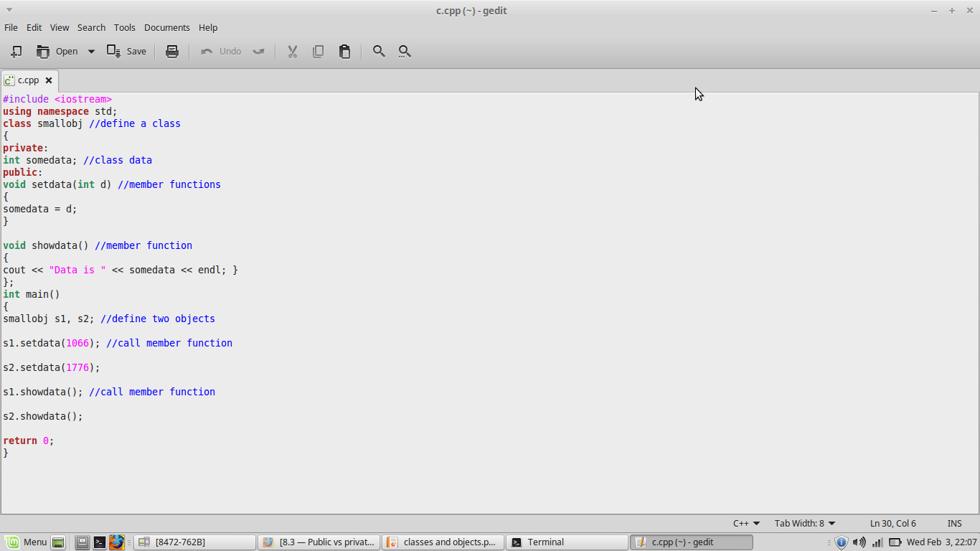
Complete Example

Slide 23
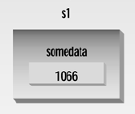
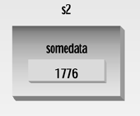
Call Member Function
int somedata;
void setdata(int d)
{
somedata = d;
}
void showdata()
{
cout << “Data is “ << somedata;
};
s1.setdata(1066);
s2.setdata(1776);
smallobj s1
setdata(1066);
setdata(1776);
smallobj
int somedata;
void setdata(int d)
{
somedata = d;
}
void showdata()
{
cout << “Data is “ << somedata;
};
smallobj s2
s1.showdata();
s2.showdata();

Slide 24
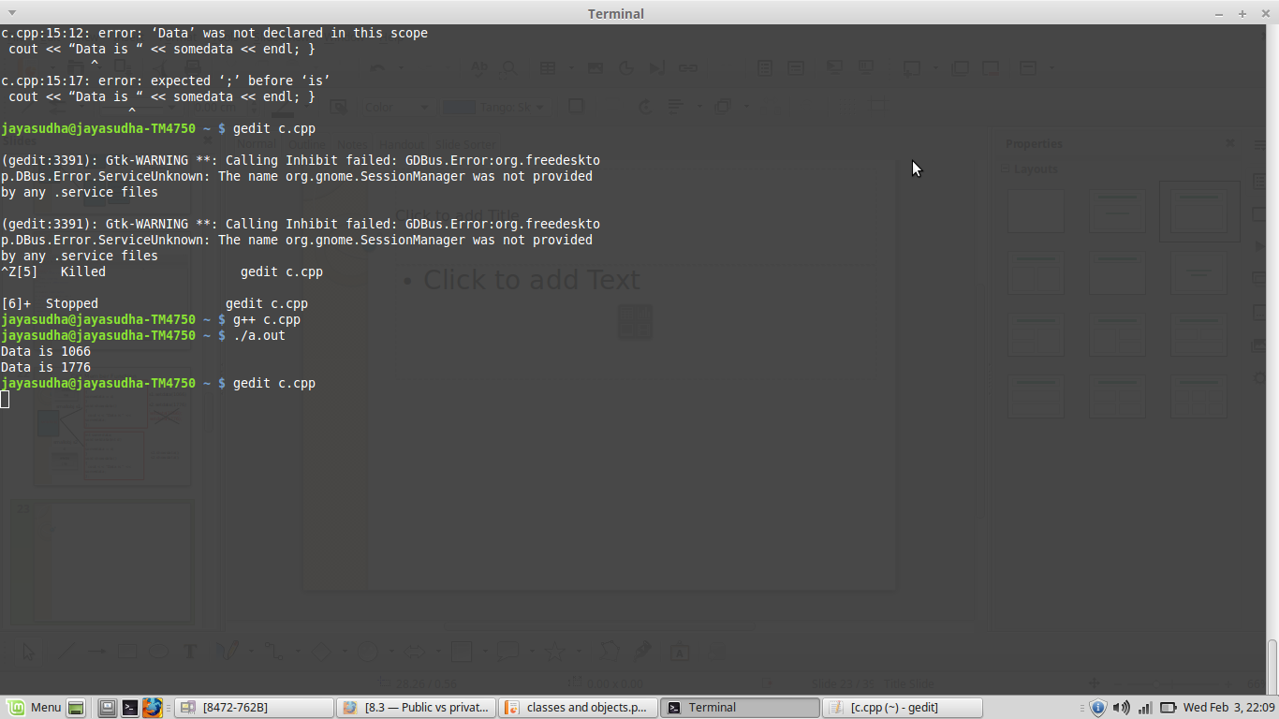

Slide 25
Creating and Using Rectangle Class
// classes example
#include <iostream>
class CRectangle {
int width, height;
public:
void set_values (int,int);
int area ()
{
return (x*y);
}
};
void CRectangle::set_values (int a, int b)
{
width = a;
height = b;
}
int main ()
{
CRectangle rect;
rect.set_values (3,4);
cout << "area: " << rect.area();
return 0;
}
25

Slide 26
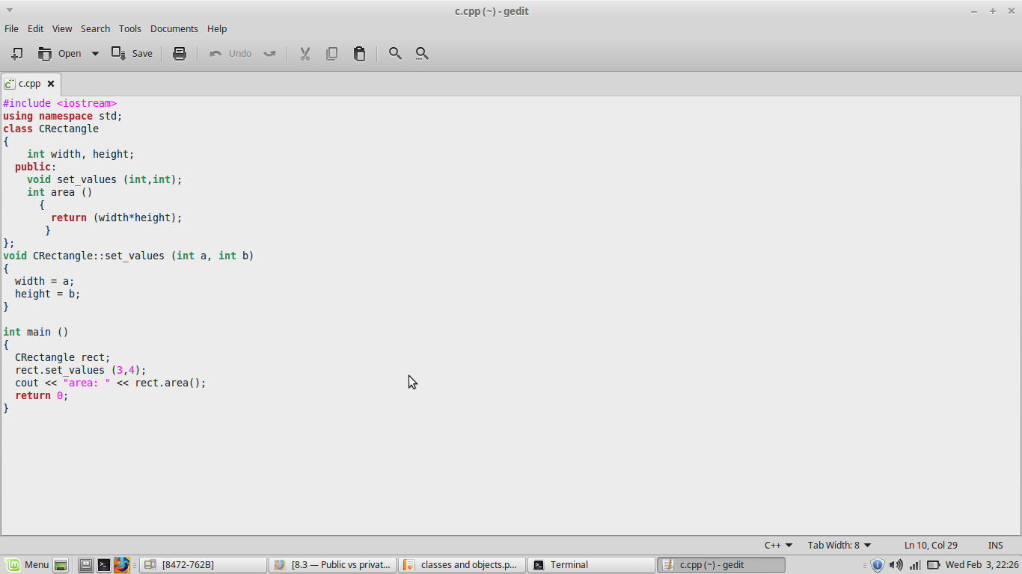

Slide 27
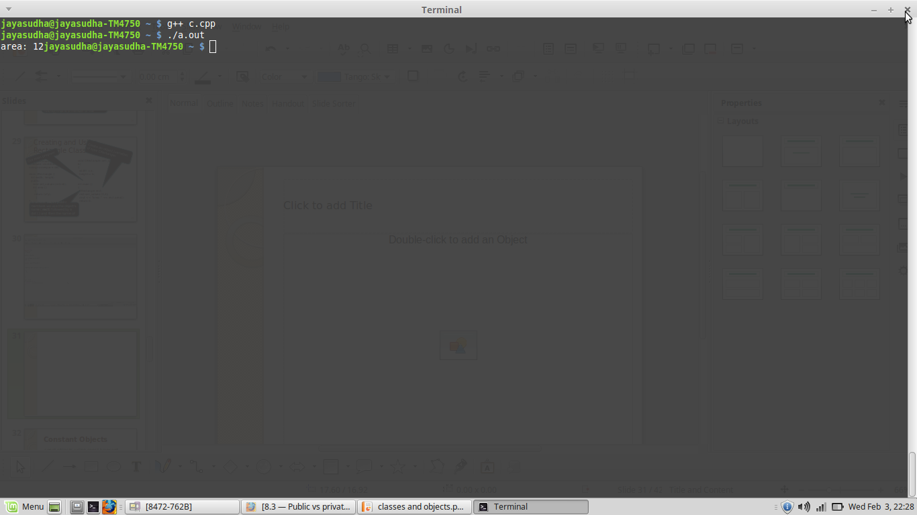

Slide 28
Creating and Using Rectangle Class
Declares a class called CRectangle
Everything inside this opening brace and the corresponding closing brace is part of to the class
// classes example
#include <iostream>
using namespace std;
class CRectangle {
int width, height;
public:
void set_values (int,int);
int area ()
{
return (x*y);
}
};
void CRectangle::set_values (int a, int b)
{
width = a;
height = b;
}
int main ()
{
CRectangle rect;
rect.set_values (3,4);
cout << "area: " << rect.area();
return 0;
}
Closing brace for the class
28

Slide 29
Creating and Using Rectangle Class
// classes example
#include <iostream>
using namespace std;
class CRectangle {
int width, height;
public:
void set_values (int,int);
int area ()
{
return (x*y);
}
};
void CRectangle::set_values (int a, int b)
{
width = a;
height = b;
}
int main ()
{
CRectangle rect;
rect.set_values (3,4);
cout << "area: " << rect.area();
return 0;
}
Function definition for set_values is done outside the CRectangle class definition itself.
We must use the operator of scope (::) to specify that we are defining a function that is a member of the class CRectangle
29

Slide 30
Creating and Using Rectangle Class
Create an object (variable) of type CRectangle.
Our main program
// classes example
#include <iostream>
using namespace std;
class CRectangle {
int width, height;
public:
void set_values (int,int);
int area ()
{
return (x*y);
}
};
void CRectangle::set_values (int a, int b)
{
width = a;
height = b;
}
int main ()
{
CRectangle rect;
rect.set_values (3,4);
cout << "area: " << rect.area();
return 0;
}
To access rect’s public members we use the object's name (rect) followed by a dot (.) and then the name of the member
30

Slide 31
Constant Objects
const objects using const keyword before object declaration.
For example:
const sample s ( m, n); // object s is constant
Notes:
31

Slide 32
Static Object
When an object is created as static, the lifetime of the object will exist throughout the program
Execution and scope of the instance will also be maintained.
Notes:
32

Slide 33
Static Object Example
#include<iostream.h>
class account
{ int acc_no;
public:
account()
{cout<<"Account constructor"; }
~account()
{cout<<"Account desctructor"; }
};
void create_stobj()
{ account vip;
}
void main(void)
{
clrscr();
account acc1;
create_stobj();
getch();
}
Account constructor
Account constructor
Account destructor
static account vip;
Account constructor
Account constructor
Notes:
33

Slide 34
Static Data Members and Member Functions
Static members are members that are single shared member common to all the objects created for a particular class.
Memory allocation is done only once and not every time an object is created.
Static functions can access only static variables
Efficient when single copy of data is enough
May seem like global variables, but have class scope
Only accessible to objects of same class
Notes:
34

Slide 35
Static Members contd.,
Static Data Members:
Object A
Object B
Static variable
Object C
Notes:
35
Static members are the class level variables
It means that the variables can be used without creating instance of the class.
Just using the class name directly these members can be accessed.
Where and why are they used
Whenever we want the state of different objects to remain same even if they are created differently we can use static members
E.g. we want to maintain a counter say of number of instances of the class created.
Only one per class no matter how many objects
As the object state is shared static members have single state irrespective of number of object created.
Can have static functions and static variables
Static member variables are the same value for all instances of the class.
Static member functions are not really the members. The idea is that you may call the static member function from any other class, if you specify the base class name where the static member function was declared. Of course, static member function cannot change the members of the class.
Static functions can access only static variables

Slide 36
Static Members contd.,
Static Member Example
class account {
private:
int currentBal;
static int RateofInt;
};
myclass A(0), B(1);
Shared by all objects
Object
B
RateofInt
Object A
currentBal=0
currentBal=1
Notes:
36

Slide 37
Static Members contd.,
Static Data Members:
class SavingsAccount
{
private:
char name[30];
float total;
float CurrentRate;
public:
SavingsAccount();
void EarnInterest()
{
total + = CurrentRate * total;
}
}
Only one copy should be available as all objects should have same Interest rate
To make CurrentRate
accessible to all objects
Declare CurrentRate as
static float CurrentRate;
Notes:
37
Static members are the class level variables
It means that the variables can be used without creating instance of the class.
Just using the class name directly these members can be accessed.
Where and why are they used
Whenever we want the state of different objects to remain same even if they are created differently we can use static members
E.g. we want to maintain a counter say of number of instances of the class created.
Only one per class no matter how many objects
As the object state is shared static members have single state irrespective of number of object created.
Can have static functions and static variables
Static member variables are the same value for all instances of the class.
Static member functions are not really the members. The idea is that you may call the static member function from any other class, if you specify the base class name where the static member function was declared. Of course, static member function cannot change the members of the class.
Static functions can access only static variables

Slide 38
Constant data member and Constant Functions
A constant variable can be declared using const keyword
Compiler error results if attempted to modify it
Syntax:
const <variable-name> = <value>
Example: const int age = 20;
const int age; // Not valid
Notes:
38
Constant members
Constant for every object
For each objects created separately if a class has any constant member defined then the value of that member for that object cannot be changed once assigned.
Set during construction time and then can not change their values.
Constant functions can access only Constant variables
What do constant functions imply? Can not change the contents of the member variables

Slide 39
Constant data member and Constant Functions
The const keyword specifies that a variable's value is constant and tells the compiler to prevent the programmer from modifying it.
Declaring a member function with the const keyword specifies that the function is a "read-only" function that does not modify the object for which it is called.
If a const function attempt to change the data, the compiler will generate an error message.
int main()
{
const int i = 5;
---
}
Notes:
39

Slide 40
Constant data member and Constant Functions
Illegal to declare a const member function that modifies a data member
For built-in types it doesn’t matter whether we return by value as a const
int fun1( ) {return 1;}
int fun2( ) const {return 1;}
main( )
{
const int i = fun1( );
int j = fun2( );
---
}
Notes:
40

Slide 41
Constant data member and Constant Functions
class Time
{
int hour;
public:
Time(int k) { hour=k; }
void update( ) { hour++; }
int value( ) const { return hour; }
void cheat( ) const { hour++; }
};
void main (void)
{
Time t(10);
cout<<t.value( );
}
// error this is const
11
Notes:
41

Slide 42
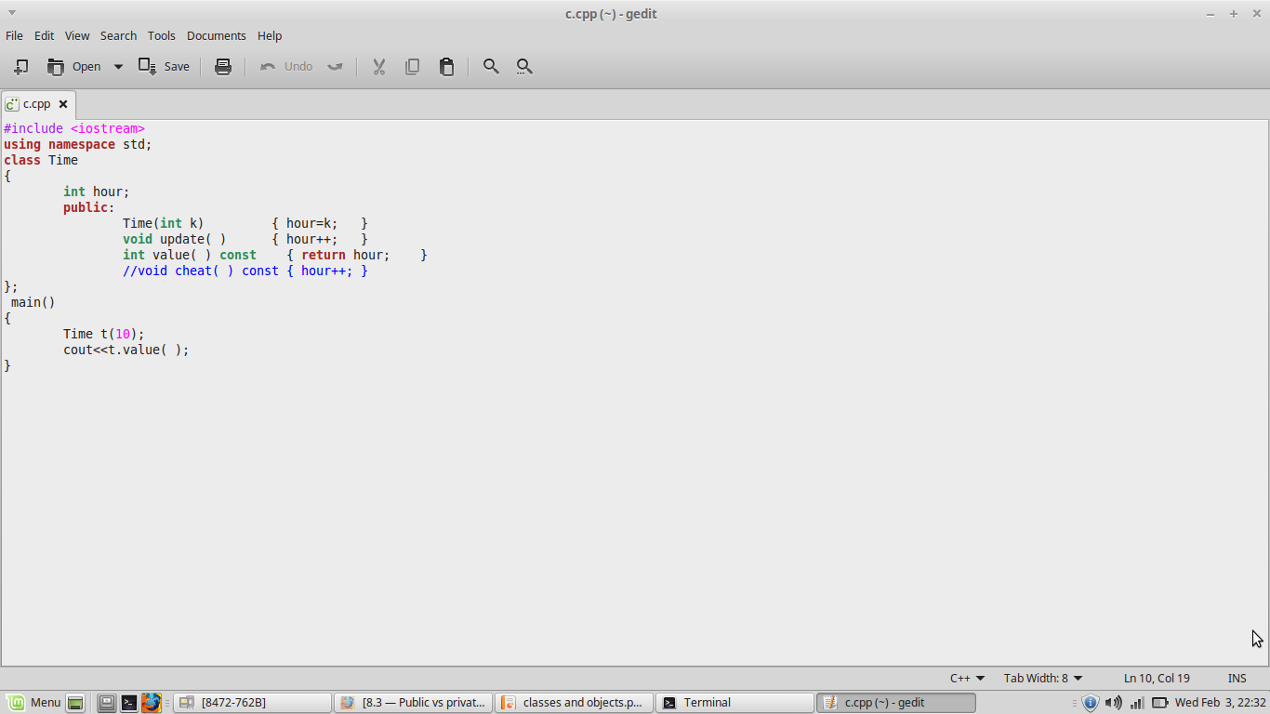
Constant data member and Constant Functions
Notes:
42

Slide 43
Imagine a tollbooth at a bridge. Cars passing by the booth are expected to pay a 50 cent toll. Mostly they do, but sometimes a car goes by without paying. The tollbooth keeps track of the number of cars that have gone by, and of the total amount of money collected.
model this tollbooth with a class called tollbooth. The two data items are a type unsigned int to hold the number of cars and a type double to hold the total amount of money collected. A constructor initializes both of these to zero. A member function called payingcar() increments the car total and adds 0.50 to the total cash. Another function called nopaycar(), increments the car total but adds nothing to the cash total. Finally a member function called display() displays the two totals.

Slide 44
Constructors
Classes control object initialization by defining one or more special member functions known as constructors.
The job of a constructor is to initialize the data members of a class object.
A constructor is run whenever an object of a class type is created.
Constructors have the same name as the class.
Unlike other functions, constructors have no return type.
Constructors can not be virtual.

Slide 45
Constructors (Contd..)
A class can have multiple constructors.
Like any other overloaded function, the constructors must differ from each other in the number or types of their parameters.
Constructors are the special type of member functions that initializes the object automatically when it is created.
Compiler identifies that the given member function is a constructor by its name.

Slide 46
Types of constructors
There are several forms in which a constructor can take its shape namely:
Default Constructor
Parameterized Constructor
Copy Constructor

Slide 47
Default constructor
Classes control default initialization by defining a special constructor, known as the default constructor. The default constructor is one that takes no arguments.
If the class does not explicitly define any constructors, the compiler will implicitly define the default constructor.
The compiler-generated constructor is known as the synthesized default constructor.

Slide 48
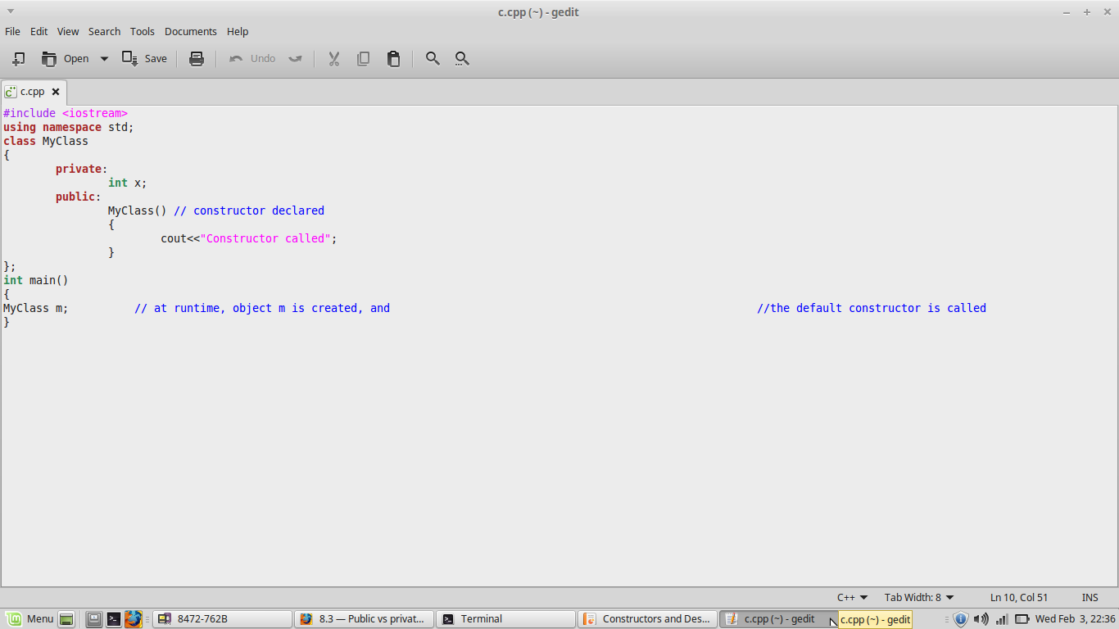
Default constructor -Example

Slide 49
Parameterized constructor
A parameterized constructor is the one that has parameters or arguments specified in it.
We can pass the arguments to constructor function when object is created.
A constructor that can take arguments is called parameterized constructor.
When a constructor is parameterized, we must pass the initial values as arguments to the constructor function when an object is declared.

Slide 50
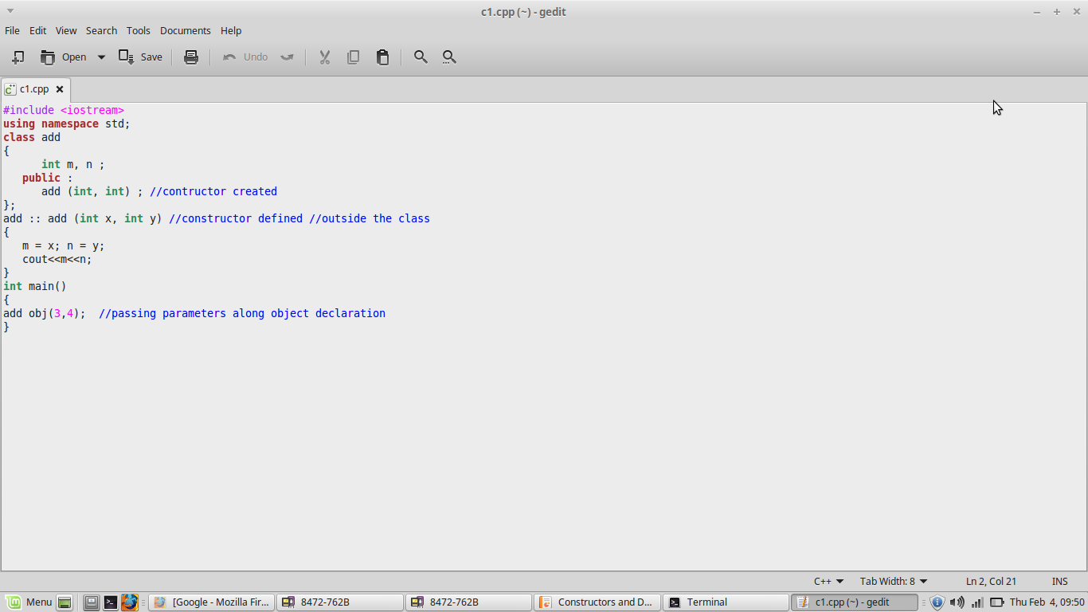
Parameterized constructor -Example

Slide 51
Copy constructor
A copy constructor is a member function which initializes an object using another object of the same class. It is used to declare and initialize an object from another object.
The most common form of copy constructor is shown here:
classname (const classname &obj)
{ // body of constructor }
Here, obj is a reference to an object that is being used to initialize another object.
Copy constructor object creation:
integer (integer & i) ; (or)
integer I 2 ( I 1 ) ; (or)
integer I 2 = I 1 ;

Slide 52
Copy constructor – (contd…)
The copy constructor creates an object by initializing it with an object of the same class, which has been created previously.
The copy constructor is used to:
Initialize one object from another of the same type.
Copy an object to pass it as an argument to a function.
Copy an object to return it from a function.
The process of initializing through a copy constructor is known as copy initialization.
A reference variable has been used as an argument to the copy constructor as we cannot pass the argument by value to a copy constructor.

Slide 53
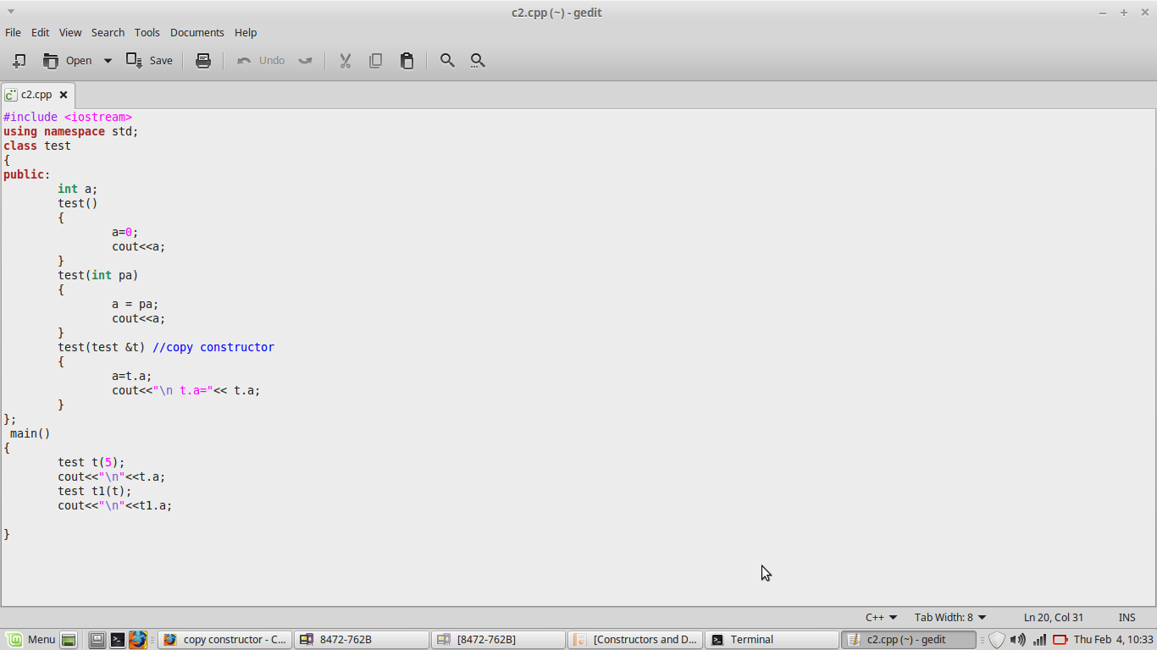

Slide 54
Destructors
A destructor is a special member function of a class that is executed whenever an object of it's class goes out of scope.
A destructor will have exact same name as the class prefixed with a tilde (~).
It can neither return a value nor can it take any parameters.
Destructor can be very useful for releasing resources before coming out of the program like closing files, releasing memories etc.
The destructor is commonly used to "clean up" when an object is no longer necessary.

Slide 55
Destructors (contd..)
Destructors are called when one of the following events occurs:
An object allocated using the new operator is explicitly deallocated using the delete operator.
A local (automatic) object with block scope goes out of scope.
The lifetime of a temporary object ends.
A program ends and global or static objects exist.

Slide 56
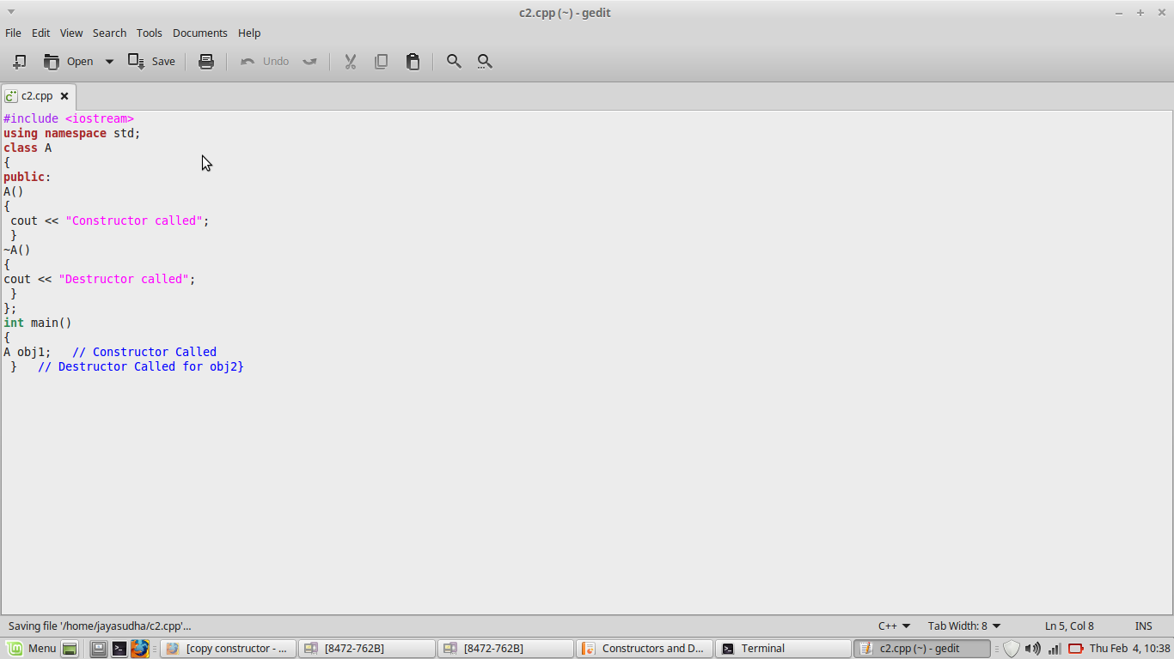
Destructor Example

Slide 57
Shallow copy
A shallow copy means that C++ copies each member of the class individually using the assignment operator.
The default copy constructor and default assignment operators it provides use a copying method known as a shallow copy (also known as a member wise copy).
when designing classes that handle dynamically allocated memory, member-wise (shallow) copying ends up in a trouble.
This is because the standard pointer assignment operator just copies the address of the pointer -- it does not allocate any memory or copy the contents being pointed to!

Slide 58
Deep copying
The answer to the problem in the previous slide is to do a deep copy on any non-null pointers being copied.
A deep copy duplicates the object or variable being pointed to so that the destination (the object being assigned to) receives it’s own local copy.
This way, the destination can do whatever it wants to it’s local copy and the object that was copied from will not be affected.
Doing deep copies requires that we write our own copy constructors and overloaded assignment operators.

Slide 59
Shallow copy: Copies the member values from one object into another.
Deep Copy: Copies the member values from one object into another. Any pointer objects are duplicated and Deep Copied.
class String{
int size;
char* data;
};
String s1("Ace");
// s1.size = 3 s1.data=0x0000F000
//In shallow copy the same location is pointed by both s1 and s2 objects
String s2 = s1;
// s2.size =3 s2.data = 0X0000F000
// In deep copy the data is copied to another location and both the objects point to the same data available in different locations.
String s3 = s1;
// s3.size =3 s3.data = 0x0000F00F // With “Ace” copied to this location.

Slide 60
Railway reservation problem

Slide 61
Output

Slide 62
In Lab Practice problems

Slide 63
Problem 1
Write a class definition that creates a class called leverage with on private data member, crowbar, of type int and one public function whose declaration is void pry(). Write a constructor that initializes to 0 the crowbar data. Assume that the constructor is define
Inside the class
Outside the class

Slide 64
Problem 2
Create a class called time that has separate int member data for hours, minutes and seconds. One constructor should initialize this data to 0. and another should initialize it to fixed values. Another member function should display it, in 11:59:59 format. The final member function should add two objects of type time passed as arguments.
A main program should create two initialized time objects and one that isn’t initialized. Then it should add the two initialized values together, leaving the result in the third time variable.

Slide 65
Dynamic memory allocation
Dynamic allocation is useful when
arrays need to be created whose extent is not known until run time
complex structures of unknown size and/or shape need to be constructed as the program runs
objects need to be created and the constructor arguments are not known until run time
Notes:
65

Slide 66
Dynamic memory allocation
Pointers need to be used for dynamic allocation of memory
Use the operator new to dynamically allocate space
Use the operator delete to later free this space

Slide 67
The new operator
If memory is available, the new operator allocates memory space for the requested object/array, and returns a pointer to (address of) the memory allocated.
If sufficient memory is not available, the new operator returns NULL.
The dynamically allocated object/array exists until the delete operator destroys it.

Slide 68
The delete operator
The delete operator deallocates the object or array currently pointed to by the pointer which was previously allocated at run-time by the new operator.
the freed memory space is returned to Heap
the pointer is then considered unassigned
If the value of the pointer is NULL there is no effect.

Slide 69
Example
int *ptr;
ptr = new int;
*ptr = 22;
cout << *ptr << endl;
delete ptr;
ptr = NULL;
ptr
FDE0
FDE1
FDE2
FDE3
0EC4
0EC5
0EC6
0EC7

Slide 70
Example (Cont ..)
int *ptr;
ptr = new int;
*ptr = 22;
cout << *ptr << endl;
delete ptr;
ptr = NULL;
ptr
FDE0
0EC4
FDE1
FDE2
FDE3
0EC4
0EC5
0EC6
0EC7

Slide 71
Example (Cont ..)
int *ptr;
ptr = new int;
*ptr = 22;
cout << *ptr << endl;
delete ptr;
ptr = NULL;
ptr
FDE0
0EC4
FDE1
FDE2
FDE3
0EC4
22
0EC5
0EC6
0EC7

Slide 72
Example (Cont ..)
int *ptr;
ptr = new int;
*ptr = 22;
cout << *ptr << endl;
delete ptr;
ptr = NULL;
ptr
FDE0
0EC4
FDE1
FDE2
FDE3
0EC4
22
Output:
22
0EC5
0EC6
0EC7

Slide 73
Example (Cont ..)
int *ptr;
ptr = new int;
*ptr = 22;
cout << *ptr << endl;
delete ptr;
ptr = NULL;
ptr
FDE0
?
FDE1
FDE2
FDE3
0EC4
0EC5
0EC6
0EC7

Slide 74
Example (Cont ..)
int *ptr;
ptr = new int;
*ptr = 22;
cout << *ptr << endl;
delete ptr;
ptr = NULL;
ptr
FDE0
0
FDE1
FDE2
FDE3
0EC4
0EC5
0EC6
0EC7

Slide 75
Dynamic allocation and deallocation of arrays
Use the [IntExp] on the new statement to create an array of objects instead of a single instance.
On the delete statement use [] to indicate that an array of objects is to be deallocated.
Notes:
75

Slide 76
Example of dynamic array allocation
int* grades = NULL;
int numberOfGrades;
cout << "Enter the number of grades: ";
cin >> numberOfGrades;
grades = new int[numberOfGrades];
for (int i = 0; i < numberOfGrades; i++)
cin >> grades[i];
for (int j = 0; j < numberOfGrades; j++)
cout << grades[j] << " ";
delete [] grades;
grades = NULL;
Notes:
76

Slide 77
Dynamic allocation of 2D arrays
A two dimensional array is really an array of arrays (rows).
To dynamically declare a two dimensional array of int type, you need to declare a pointer to a pointer as:
int **matrix;

Slide 78
Dynamic allocation of 2D arrays (Cont ..)
To allocate space for the 2D array with r rows and c columns:
You first allocate the array of pointers which will point to the arrays (rows)
matrix = new int*[r];
This creates space for r addresses; each being a pointer to an int.
Then you need to allocate the space for the 1D arrays themselves, each with a size of c
for(i=0; i<r; i++)
matrix[i] = new int[c];

Slide 79
Dynamic allocation of 2D arrays (Cont ..)
The elements of the array matrix now can be accessed by the matrix[i][j] notation
Keep in mind, the entire array is not in contiguous space (unlike a static 2D array)
The elements of each row are in contiguous space, but the rows themselves are not.
matrix[i][j+1] is after matrix[i][j] in memory, but matrix[i][0] may be before or after matrix[i+1][0] in memory

Slide 80
Example
// create a 2D array dynamically
int rows, columns, i, j;
int **matrix;
cin >> rows >> columns;
matrix = new int*[rows];
for(i=0; i<rows; i++)
matrix[i] = new int[columns];
// deallocate the array
for(i=0; i<rows; i++)
delete [] matrix[i];
delete [] matrix;

Slide 81
Pointers to objects

Slide 82
Pointers to objects
Any type that can be used to declare a variable/object can also have a pointer type.
Consider the following class:
class Rational
{
private:
int numerator;
int denominator;
public:
Rational(int n, int d);
void Display();
};
82

Slide 83
Pointers to objects (Cont..)
Rational *rp = NULL;
Rational r(3,4);
rp = &r;
rp
FFF0
0
FFF1
FFF2
FFF3
FFF4
FFF5
FFF6
FFF7
FFF8
FFF9
FFFA
FFFB
FFFC
FFFD

Slide 84
Pointers to objects (Cont..)
Rational *rp = NULL;
Rational r(3,4);
rp = &r;
rp
FFF0
0
FFF1
FFF2
FFF3
FFF4
3
FFF5
FFF6
numerator = 3
denominator = 4
r
FFF7
FFF8
4
FFF9
FFFA
FFFB
FFFC
FFFD

Slide 85
Pointers to objects (Cont..)
Rational *rp = NULL;
Rational r(3,4);
rp = &r;
rp
FFF0
FFF4
FFF1
FFF2
FFF3
FFF4
3
FFF5
FFF6
numerator = 3
denominator = 4
r
FFF7
FFF8
4
FFF9
FFFA
FFFB
FFFC
FFFD

Slide 86
Pointers to objects (Cont..)
If rp is a pointer to an object, then two notations can be used to reference the instance/object rp points to.
Using the de-referencing operator *
(*rp).Display();
Using the member access operator ->
rp -> Display();

Slide 87
Dynamic Allocation of a Class Object
Consider the Rational class defined before
Rational *rp;
int a, b;
cin >> a >> b;
rp = new Rational(a,b);
(*rp).Display(); // rp->Display();
delete rp;
rp = NULL;

Slide 88
malloc() vs new
new calls constructors
malloc() directly calls memory location through function
Primitive data types (char, int, float.. etc) can also be initialized with new. For example, below program prints 10.
new returns exact data type
malloc() returns void *.

Slide 89
delete and free() in C++
delete operator used either for the pointers pointing to the memory allocated using new operator or for a NULL pointer.
free() used either for the pointers pointing to the memory allocated using malloc() or for a NULL pointer.

Slide 90
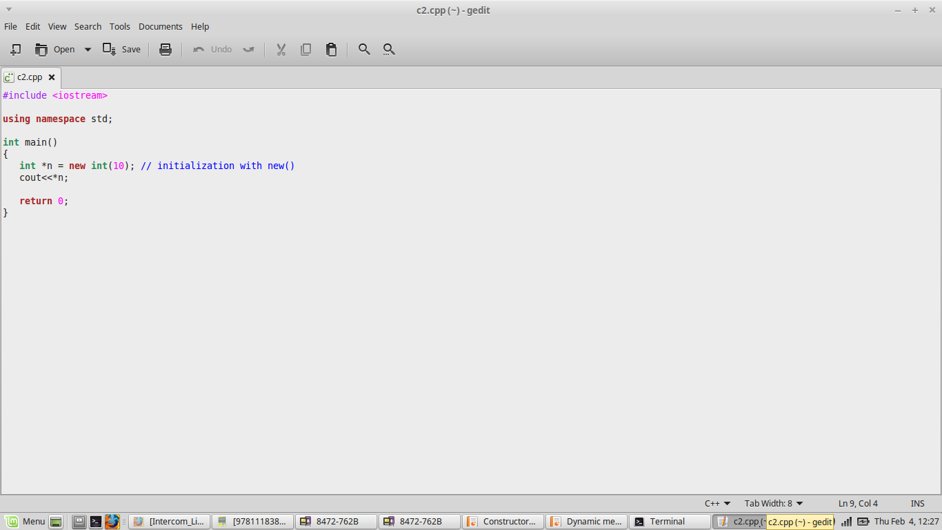

Slide 91
