Slide 1
This pointer, Dynamic memory allocation, Constructors and Destructor

Slide 2
Scope Resolution Operator
New operator in C++
Has many roles
To define member functions outside classes
Initialization of static data members
To access a global variable with same name as that of local variable

Slide 3
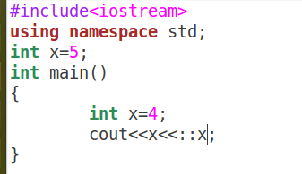

Slide 4
This pointer
‘this’ pointer is passed as a hidden argument to all nonstatic member function calls and is available as a local variable within the body of all nonstatic functions
constant pointer that holds the memory address of the current object
Not available in static member functions as static member functions can be called without any object (with class name).

Slide 5
When local variable’s name is same as member’s name
‘this’ pointer is passed as a hidden argument to all nonstatic member function calls and is available as a local variable within the body of all nonstatic functions
constant pointer that holds the memory address of the current object
Not available in static member functions as static member functions can be called without any object (with class name).

Slide 7
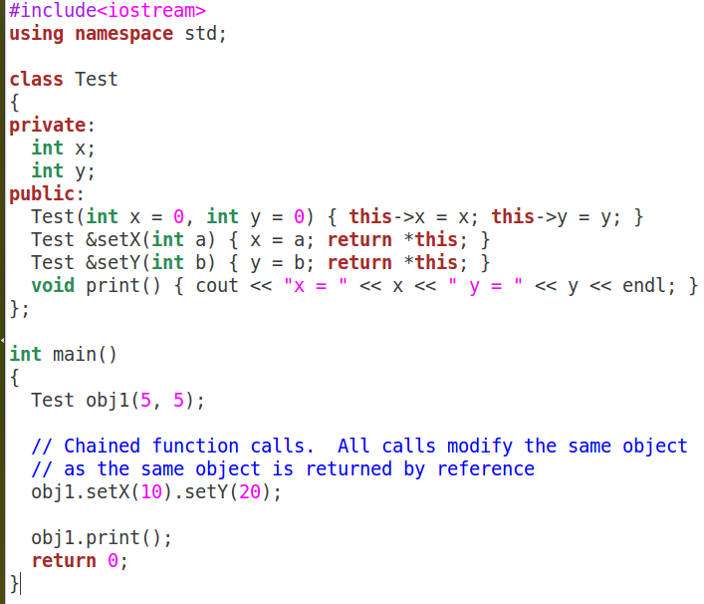

Slide 8
New and delete in C++
Similar to malloc and free in C
But there is an option to initialize memory
Can be used allocate memory for single or array of elements

Slide 9
New and delete in C++
If memory is available, the new operator allocates memory space for the requested object/array, and returns a pointer to (address of) the memory allocated.
If sufficient memory is not available, the new operator returns NULL.
Dynamically allocated object/array exists until the delete operator destroys it

Slide 10
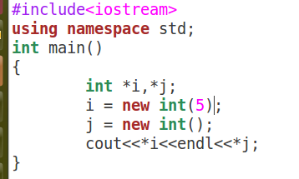

Slide 11
Constructors
Special type of member functions
Have same name as class
Automatically called by system during object creation
Should be with public access specifier
Should allocate memory if required
Should initialize data members

Slide 12
Constructors
Three types
Default – No Parameters
Parameterized
Copy
If no constructor is provided then compiler provides one in C++
Compiler created default constructor has empty body and doesn’t initialize
Compiler doesn’t create a default constructor if we write any constructor

Slide 13
Parameterized Constructors
Parameters are passed to initialize data members
Default arguments may be present
Parameterized constructors may be overloaded

Slide 14
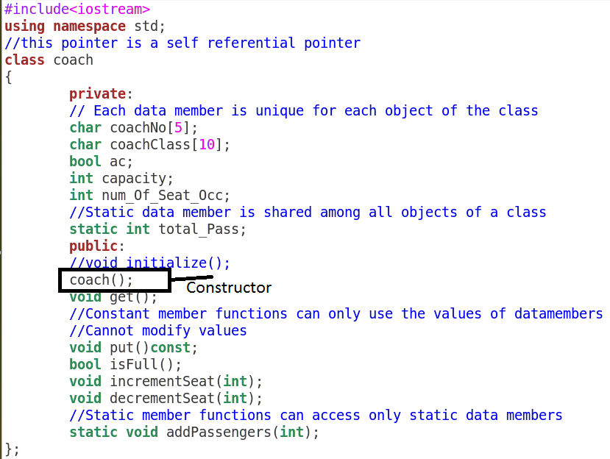

Slide 15
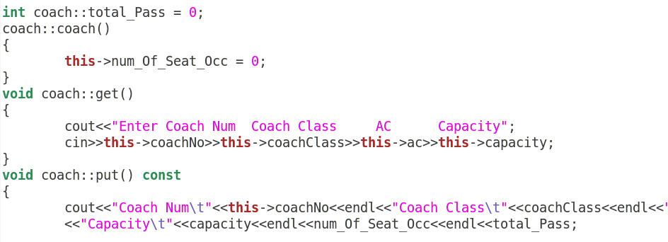

Slide 17
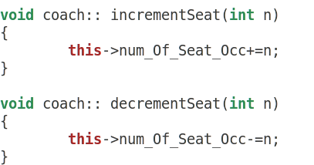

Slide 18
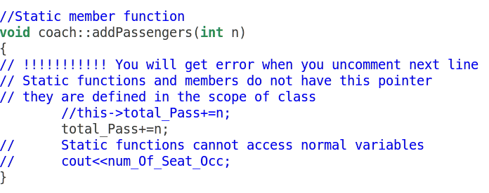

Slide 19
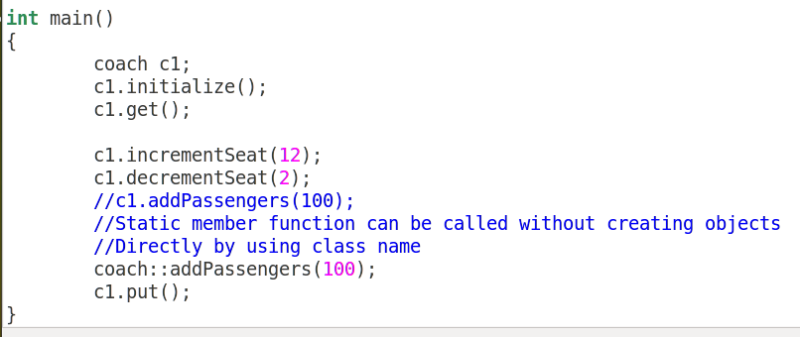

Slide 20
Copy Constructors
Important when class has pointer data members and dynamic memory allocation is done in default constructor
Compiler creates a copy constructor if we don’t write our own copy constructor.
But does something called shallow copying
Address is copied instead of allocating memory and copying content

Slide 21
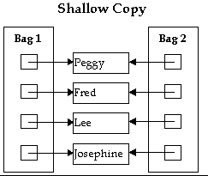

Slide 22
Problem without Copy Constructors
Two objects refer to same memory location
Unsafe
At any point of time the other object’s life may end
Leads to dangling pointers – Pointer with address which is not valid

Slide 23
Copy Constructors
Compiler creates a copy constructor if we don’t write our own copy constructor.
So we need to write copy constructor only when we have pointers or run time allocation of resource like file handle, a network connection, etc

Slide 24
When is copy constructor called?
In C++, a Copy Constructor may be called in following cases: 1. When an object of the class is returned by value. 2. When an object of the class is passed (to a function) by value as an argument. 3. When an object is constructed based on another object of the same class. 4. When compiler generates a temporary object.

Slide 25
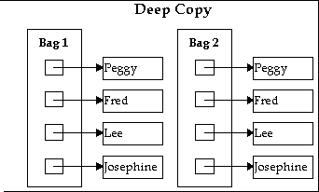

Slide 26
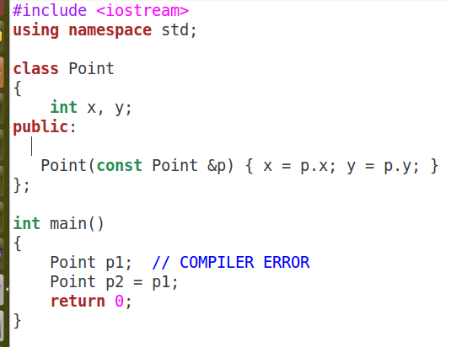
When one constructor (either parameterized or copy) is provided, it is mandatory to provide default constructor

Slide 27
Argument to Copy constructor must be constant
When objects are returned the argument of copy constructor should be const
Because compiler will create temporary object and invoke copy constructor to copy values from temporary object
compiler created temporary objects cannot be bound to non-const references

Slide 28
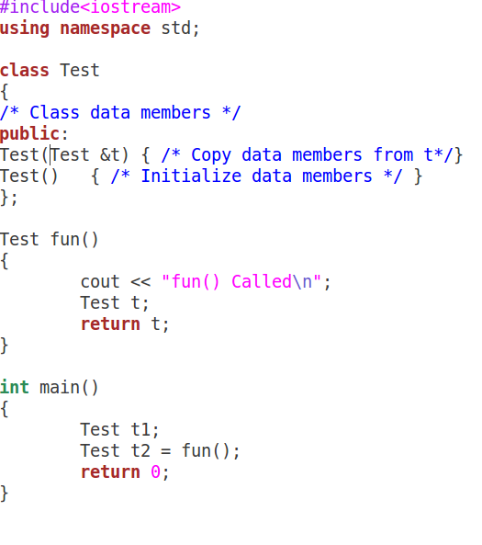

Slide 29
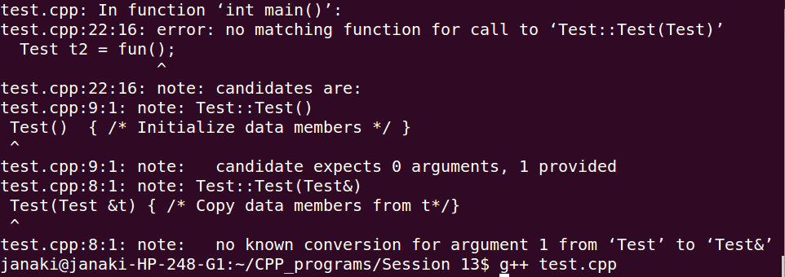

Slide 30
Why argument to a copy constructor must be passed as a reference?
A copy constructor is called when an object is passed by value.
Copy constructor itself is a function.
So if we pass argument by value in a copy constructor, a call to copy constructor would be made to call copy constructor which becomes a non-terminating chain of calls.
Therefore compiler doesn’t allow parameters to be pass by value.

Slide 31
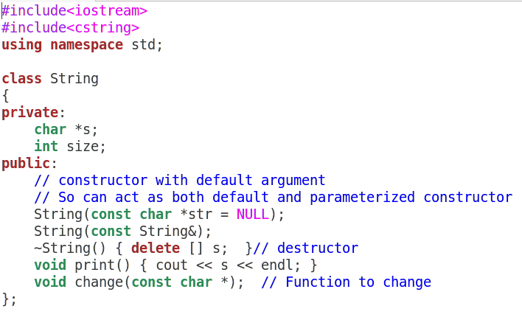

Slide 32
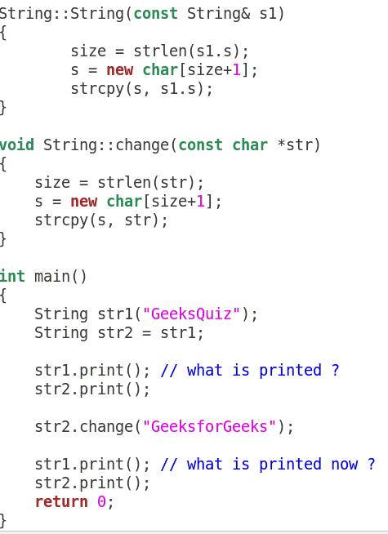

Slide 33
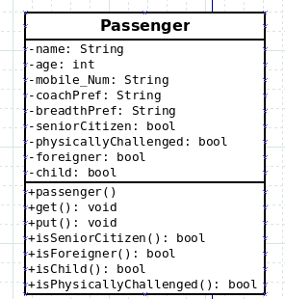

Slide 34
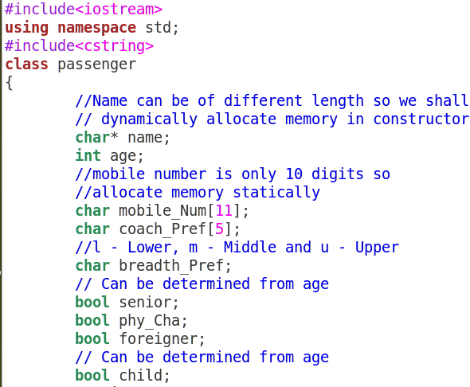

Slide 35
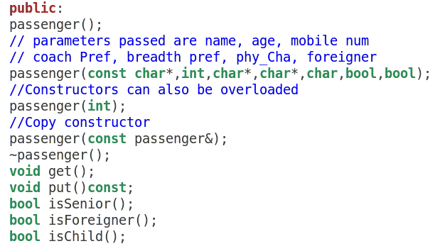

Slide 36
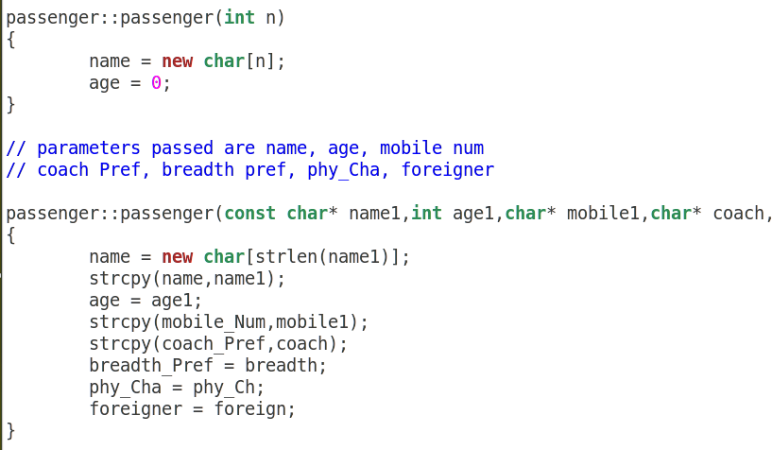

Slide 38
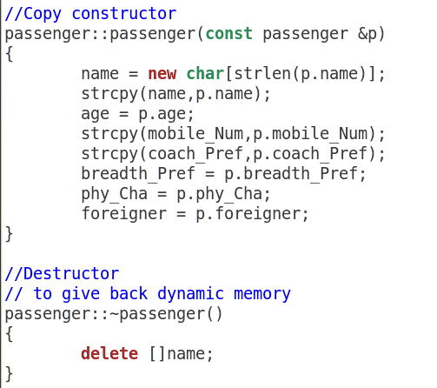

Slide 39
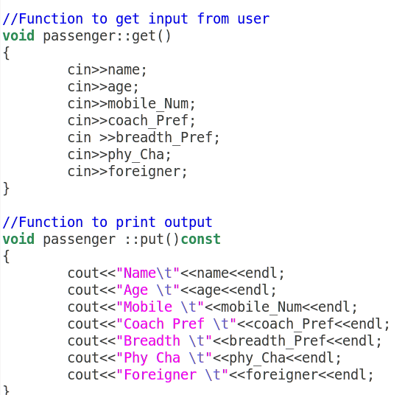

Slide 40
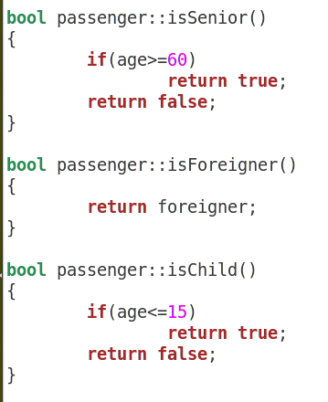

Slide 41
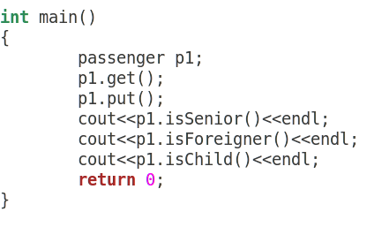

Slide 42
In Lab Practice
Develop a class complex numbers
Develop a class vector, dynamically allocate memory

