Slide 1
Session 16
Friend Function

Slide 2
Problem solving by Exhaustive Approach
Exhaustive approach or brute-force approach
also known as generate and test.
It is a very general problem-solving technique that
consists of systematically enumerating all possible
methods for the solution and checking whether
each method satisfies the problem's statement.

Slide 3
Eight Queens Problem
we have to arrange 8 queens in a 64-square
chessboard chess board such that no two queens
attack each other.
This puzzle is called the 8 queens puzzle.
We can solve this puzzle by examining all possible
arrangements of 8 queens on the chessboard, and,
for each arrangement, we need to check whether
each queen can attack any other queen.

Slide 4
Factors of a given number
A brute-force algorithm to find the divisors of a
natural number n would enumerate all integers from
1 to n, and check whether each of them divides n
without remainder.
This problem is solvable by brute force strategy
because it checks all values from 1 to n to find the
divisors for the given number.

Slide 5
Cabbage , Goat, Wolf - Farmer problem
A farmer wants to cross a river and take with him a wolf,
a goat, and cabbage.
There is a boat that can fit himself plus either the wolf,
the goat, or the cabbage.
If the wolf and the goat are alone on one shore, the wolf
will eat the goat.
If the goat and the cabbage are alone on the shore, the
goat will eat the cabbage.
How can the farmer bring the wolf, the goat, and the
cabbage across the river?

Slide 6
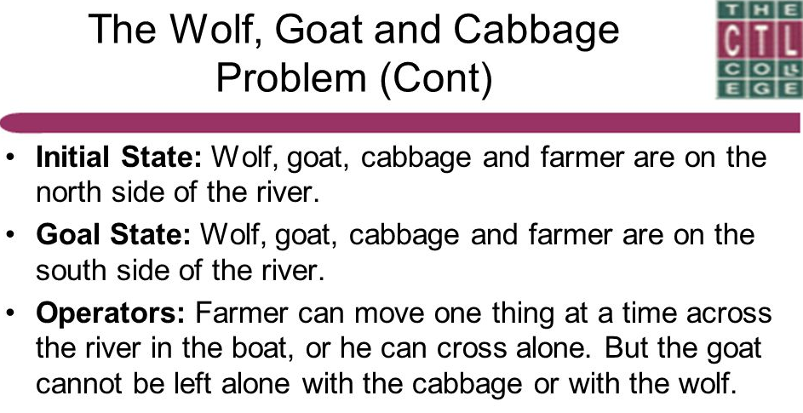

Slide 7
Cabbage , Goat, Wolf - Farmer problem (cont’d)
Exhaustive search has to be performed
Find all possible movement in boat

Slide 8
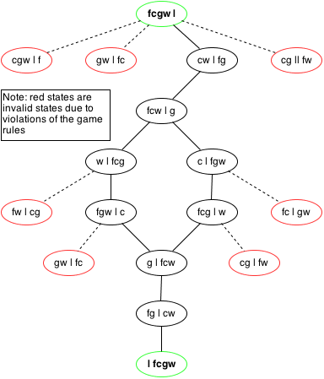

Slide 9
CASE STUDY - RRS
Develop a function to calculate total fare for a ticket. There are ‘n’ passengers in the ticket and they are from a family of a railway employee. Discount is given for their travel based on the cader of the employee.

Slide 10
Railway Revenue Calculation Problem
Input | Output | Logic Involved
Details of passengers travelled and cader of employee | Total fare of ticket | Provide discount based on cader of employee

Slide 11
Friend Function
The concepts of encapsulation and data hiding dictate that non-member functions should not be able to access an object’s private or protected data.
However, there are situations where such rigid discrimination leads to considerable inconvenience.

Slide 12
Friend Function
A friend function is a function that can access the non-public members of a class, even though the function itself is not a member of the class.
A friend function is a normal function with special access privileges.

Slide 13
Friend Function
A friend function of a class is a non-member function of a class that has the right to access all private and protected (non-public) members of the class.
Friend function prototype should be placed inside the class definition (can be any where inside the class definition).
Friend function definition should be outside the class scope.
Even though the prototypes of friend functions appear in the class definition, friends are not member functions.

Slide 14
A friend function of a class can be a
  function (non-member of a class)
  member function of another class
  function template
To declare a function as a friend of a class, precede the function prototype in the class definition with keyword friend.
Friend functions are used in Operator overloading to increase the versatility of operators.

Slide 15
General Syntax
class ClassName {
...... .... ........
friend returnType functionName( arguments ); // friend function declaration
...... .... ........
};
// friend function definition does not start with friend keyword
returnType functionName( arguments ) {
…. …. ….
// private and protected data of the above class can be accessed from this function
…. …. …. }
int main( ) { ….
functionName( arguments ); // Call to the friend function
…..}

Slide 16
Sample Program 1

Slide 18
Difference between Friend function and Member function
Member Function | Friend Function
It is invoked through an object | Not invoked through an object since it is a non-member of a class If the friend function of class X is a member function of class Y, then it must be invoked through an object of class Y
Can access the non-public members of the class directly | Can access the non-public members of the class only through an object (since this pointer is not visible)

Slide 19
Sample Program 2

Slide 21
Sample Program 3

Slide 24
Friends to more than One Class Act as Bridges
Imagine that you want a function to operate on objects of two different classes.
Perhaps the function will take objects of the two classes as arguments, and operate on their private data. Here’s a simple example, that shows how friend functions can act as a bridge between two classes.

Slide 28
Breaching the Walls
Friend function violates the concepts of data hiding, the philosophy that only member functions can access a class’s private data.
How serious is the breach of data integrity when friend functions are used?
A friend function must be declared as such within the class whose data it will access. Thus a programmer who does not have access to the source code for the class cannot make a function into a friend.
In this respect, the integrity of the class is still protected.
Friend functions are conceptually messy, and potentially lead to a spaghetti-code situation if numerous friends muddy the clear boundaries between classes.
For this reason friend functions should be used sparingly. If you find yourself using many friends, you may need to rethink the design of the program.

Slide 29
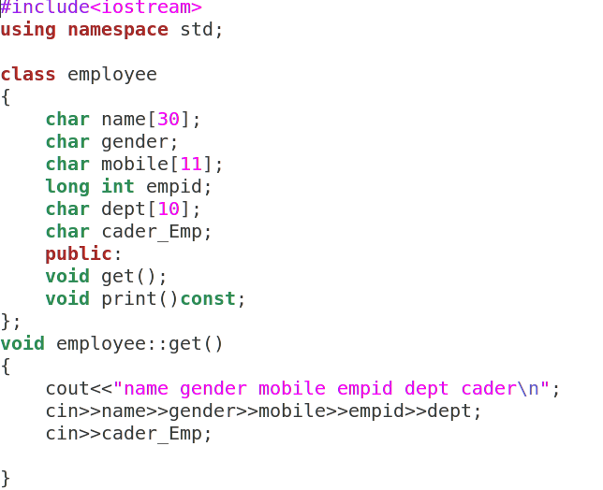

Slide 30
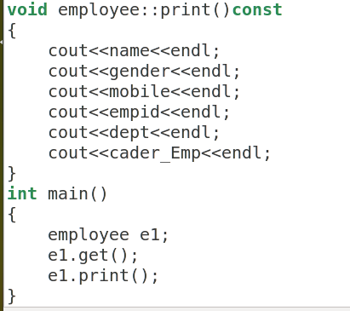

Slide 31
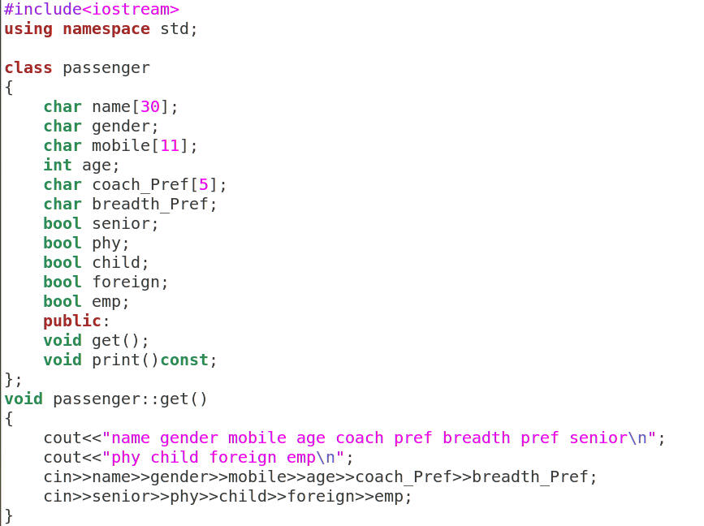

Slide 32
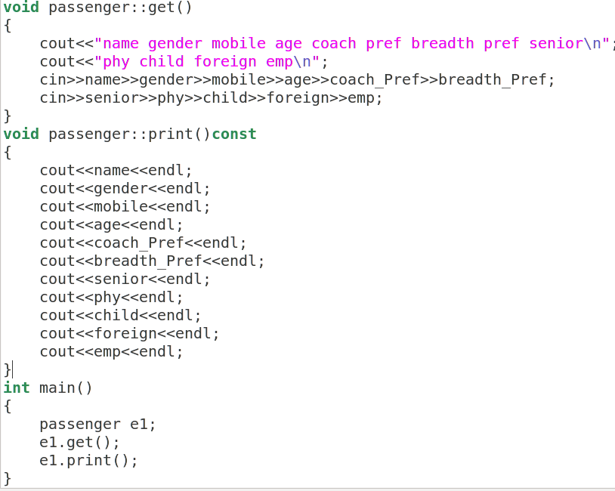

Slide 33
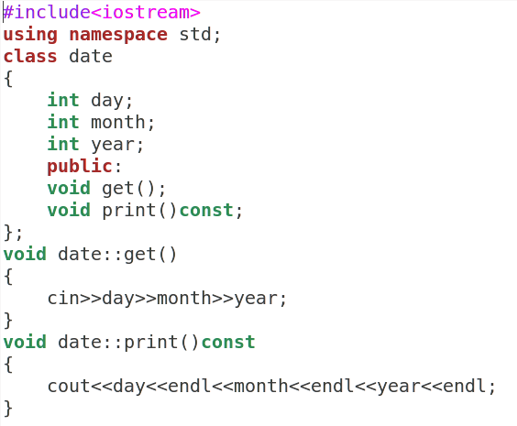

Slide 34
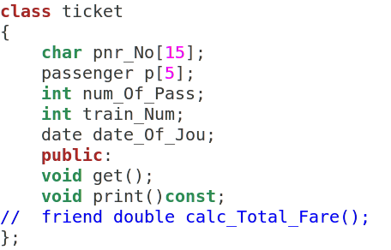

Slide 35
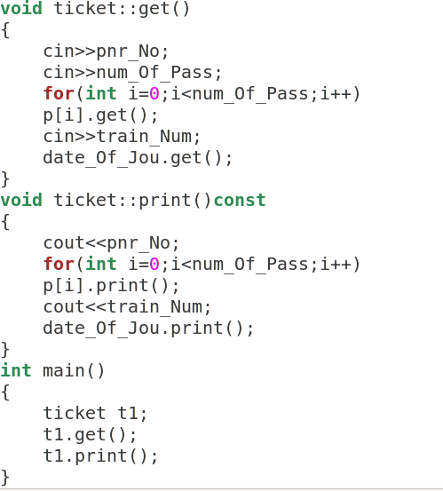

Slide 36
Friend Function Demo
Open file named as total_Fare.cpp
and explain case study

