Slide 1
Session 17 Friend class

Slide 2
CASE STUDY - RRS
Basically there are two gauges in Indian railway system.
Meter gauge and broad gauge
A coach can be attached to a train of the same type only
Meter gauge coach can be attached to only meter gauge train
So class train has to friend of class coach

Slide 3
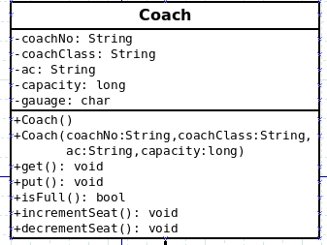

Slide 4
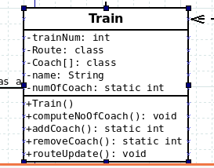

Slide 5
Friend class
Member functions of a class X operate on the data members of Class X.
At times, we need a helper class to operate on non-public data members of the class X. In such circumstances, the helper class has to be treated as a friend of class X to access the non-public data members of class X.
So, a class can be a friend of another class
For example:
If class Y is a friend of class X then
All the member functions of class Y can access the non-public members of class X

Slide 6
General Syntax
class employer;// forward declaration of class Y
class employee {
…… …
friend class employer;// friend class declaration
…… …
};
class employer {
// All the member functions of class employer can access non-public members of class employee using an object
};

Slide 7
Friend class
Friendship is not symmetric
e.g If class Y is a friend of class X then
class X is not a friend of class Y
Friendship is not transitive
e.g If class X is a friend of class Y and If class Y is a friend of class Z then
class X is not a friend of class Z

Slide 8
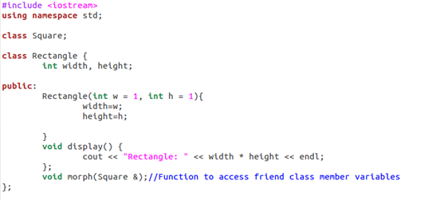
Sample Program 1

Slide 9
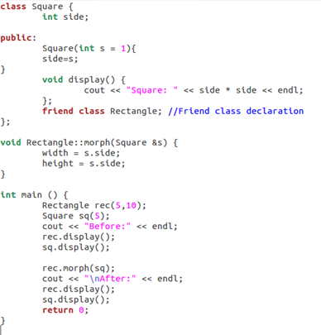

Slide 10
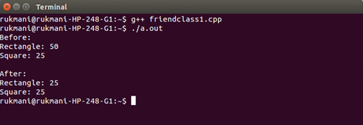

Slide 11
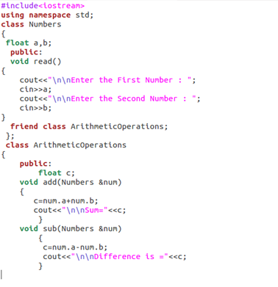
Sample Program 2

Slide 12
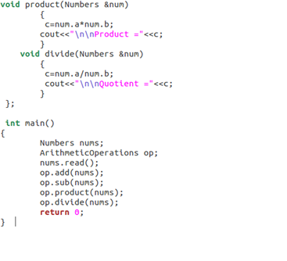

Slide 13
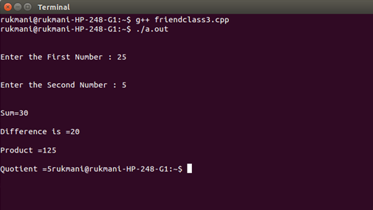

Slide 14
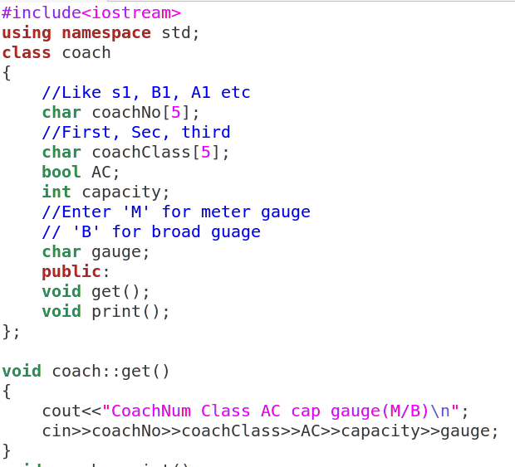

Slide 15
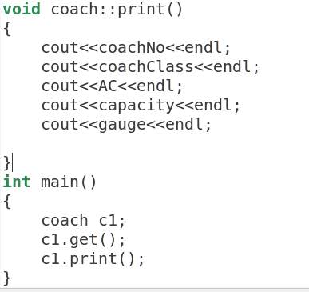

Slide 16
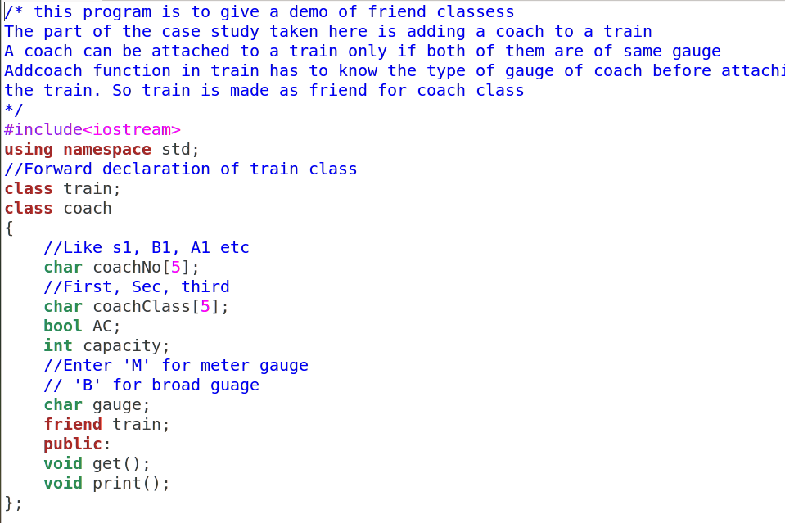
Open Train.cpp for Demo

Slide 17
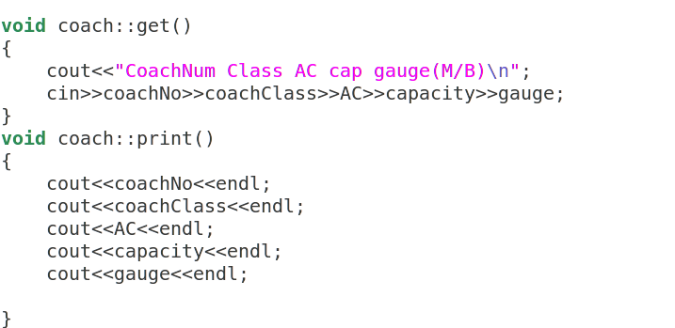

Slide 18
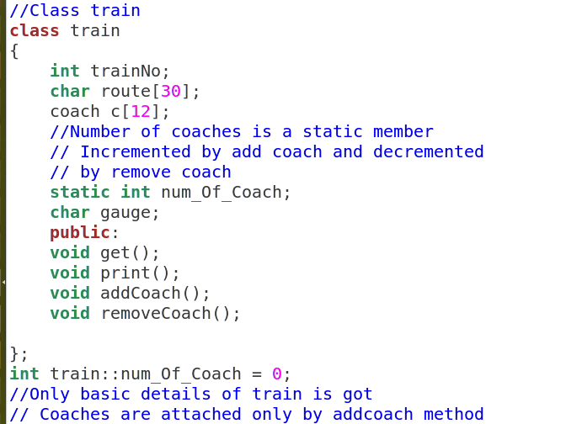

Slide 19
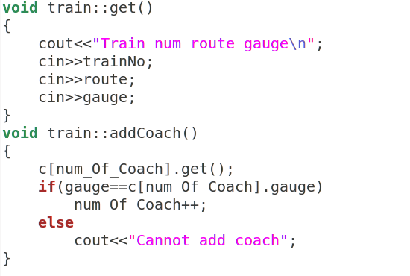

Slide 20
