Slide 2
UML-Class Diagrams

Slide 3
Order placement problem
A Company has two types of customers, corporate customers and personal customers. All customers can place orders. Every order is placed by a customer. Every order has a unique order number and the order is confirmed by the payment. Identify the classes and their relationships.

Slide 4
Modeling
Describing a system at a high level of abstraction
A model of the system
Used for requirements and specifications
Is it necessary to model software systems?
Ans: Yes if you need Quality development process
Notes:
1.
Describing the system at abstract level to comprehend its complexity
2.
Necessary to manage complexity
Good for quick understanding of the systems
Less chances of conflicting views b/w end-user and system designers

Slide 5
What is UML?
UML stands for “Unified Modeling Language”
It is a industry-standard graphical language for specifying, visualizing, constructing, and documenting the artifacts of software systems
The UML uses mostly graphical notations to express the OO analysis and design of software projects.
Simplifies the complex process of software design
Notes:
. What does UML stand for?
. Industry standard
. Graphical notation
. Modeling tool … simplifies software design process

Slide 6
Why UML for Modeling
Use graphical notation to communicate more clearly than natural language (imprecise) and code(too detailed).
Help acquire an overall view of a system.
UML is not dependent on any one language or technology.
UML moves us from fragmentation to standardization.
Notes:
. More precise than natural language … less detailed than source code
. Not dependent on any language
. Standardized by various groups

Slide 7
Class diagram
Used for describing structure and behavior in the use cases
Provide a conceptual model of the system in terms of entities and their relationships
Used for requirement capture, end-user interaction
Detailed class diagrams are used for developers

Slide 8
Class representation
Each class is represented by a rectangle subdivided into three compartments
Name
Attributes
Operations
Modifiers are used to indicate visibility of attributes and operations.
‘+’ is used to denote Public visibility (everyone)
‘#’ is used to denote Protected visibility (friends and derived)
‘-’ is used to denote Private visibility (no one)
By default, attributes are hidden and operations are visible.

Slide 9
An example of Class
Name
Account_Name
- Customer_Name
- Balance
Attributes
+addFunds( )
+withDraw( )
+transfer( )
Operations

Slide 10
OO Relationships
There are two kinds of Relationships
Generalization (parent-child relationship)
Association (student enrolls in course)
Associations can be further classified as
Aggregation
Composition

Slide 11
OO Relationships: Generalization
Supertype
Example:
Customer
Regular
Customer
Loyalty
Customer
Subtype1
Subtype2
or:
Customer
- Generalization expresses a parent/child relationship among related classes.
- Used for abstracting details in several layers
Regular
Customer
Loyalty
Customer

Slide 12
OO Relationships: Association
Represent relationship between instances of classes
Student enrolls in a course
Courses have students
Courses have exams
Etc.
Association has two ends
Role names (e.g. enrolls)
Multiplicity (e.g. One course can have many students)
Navigability (unidirectional, bidirectional)

Slide 13
OO Relationships: Aggregation
Container Class
Class C
Aggregation: expresses a relationship among instances
of related classes. It is a specific kind of Container-Containee relationship.
It expresses a relationship where an instance of the Container-class has the responsibility to hold and maintain instances of each Containee-class that have been created outside the auspices of the Container-class. Aggregation should be used to express a more informal relationship than composition expresses. That is, it is an appropriate relationship where the Container and its Containees can be manipulated independently.
Aggregation is appropriate when Container and Containees have no special access privileges to each other.
AGGREGATION
Class E₁
Class E₂
Containee Classes
Example
Bag
Apples
Milk
[From Dr.David A. Workman]

Slide 14
OO Relationships: Composition
Composition: expresses a relationship among instances
of related classes. It is a specific kind of Whole-Part relationship.
It expresses a relationship where an instance of the Whole-class has the responsibility to create and initialize instances of each Part-class. It may also be used to express a relationship where instances of the Part-classes have privileged access or visibility to certain attributes and/or behaviors defined by the Whole-class. Composition should also be used to express relationship where instances of the Whole-class have exclusive access to and control of instances of the Part-classes.
Composition should be used to express a relationship where the behavior of Part instances is undefined without being related to an instance of the Whole. And, conversely, the
behavior of the Whole is ill-defined or incomplete if one or more of the Part instances are undefined.
Whole Class
Class W
Class P₁
Class P₂
Part Classes
Example
Automobile
Engine
Transmission
[From Dr.David A. Workman]

Slide 15
Aggregation vs. Composition
Composition is really a strong form of aggregation
components have only one owner
components cannot exist independent of their owner
components live or die with their owner
e.g. Each car has an engine that can not be shared with other cars.
Aggregations may form "part of" the aggregate, but may not be essential to it. They may also exist independent of the aggregate.
e.g. Apples may exist independent of the bag.

Slide 16
Order placement problem-Class diagram

Slide 17
Association: Multiplicity and Roles
student
1
*
University
Person
0..1
*
employer
teacher
Role
Multiplicity
Symbol Meaning
1 One and only one
0..1 Zero or one
M..N From M to N (natural language)
* From zero to any positive integer
0..* From zero to any positive integer
1..* From one to any positive integer
Role
“A given university groups many people; some act as students, others as teachers. A given student belongs to a single university; a given teacher may or may not be working for the university at a particular time.”

Slide 18
More Example on Class Diagram
Name
Order
class
Multiplicity: mandatory
Attributes
-dateReceived
*
Customer
-isPrepaid
1
-number :String
-name
-price : Money
-address
Operations
+dispatch()
Association
+creditRating() : String()
+close()
1
{if Order.customer.creditRating is
Generalization
"poor", then Order.isPrepaid must
be true }
Corporate Customer
Personal Customer
Constraint
(inside braces{}}
-contactName
-creditCard#
-creditRating
Multiplicity:
Many value
-creditLimit
+remind()
+billForMonth(Integer)
Multiplicity: optional
0..1
*
*
Employee
OrderLine
-quantity: Integer
*
1
Product
-price: Money
-isSatisfied: Boolean
[from UML Distilled Third Edition]

Slide 19
Association: Model to Implementation
*
4
Student
Course
has
enrolls
Class Student {
Course enrolls[4];
}
Class Course {
Student have[];
}

Slide 20
Dia tool demo

Slide 21
How to install dia in Mint

Slide 23
Where to get dia??
Other Linux OS distributions
http://dia-installer.de/download/linux.html
Windows OS
http://dia-installer.de/download/index.html

Slide 24
About dia
It is a Open Source cross-platform diagramming program. It is very powerful, easy to use, and free of charge.
Dia is a modeling tool application that can be used to make a large variety of diagram
The Dia has special shapes/objects to draw the entity- relationship diagrams, UML diagrams, flowcharts, network diagrams, and many other diagrams.

Slide 25
Dia toolbar and Blank Canvas

Slide 26
How to create the class “Account” in dia?
Account
accno:int
acctype:String
name:String
balance:float
deposit(a:int):void
withdraw(a:int):int
enquire():String

Slide 27
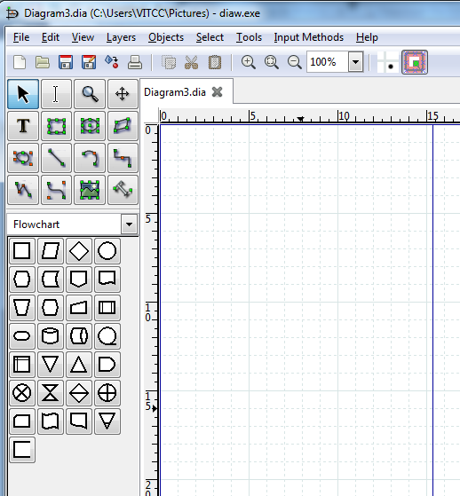
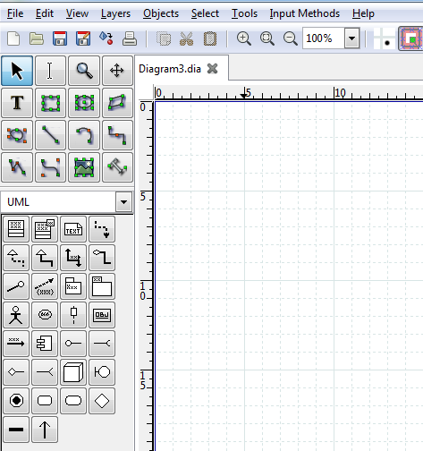
Choose the option “UML”
From the select box

Slide 28
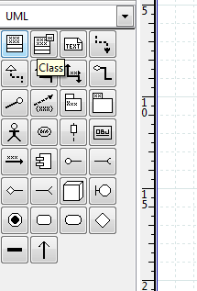
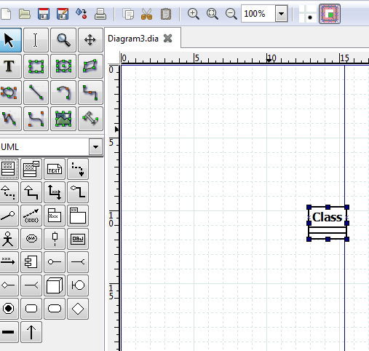
Select the class from the tool bar and Drag and drop it in to the canvas
Select “class”

Slide 29
Double click the compartment “Class”

Slide 30
Edit the class name as “Account”

Slide 31
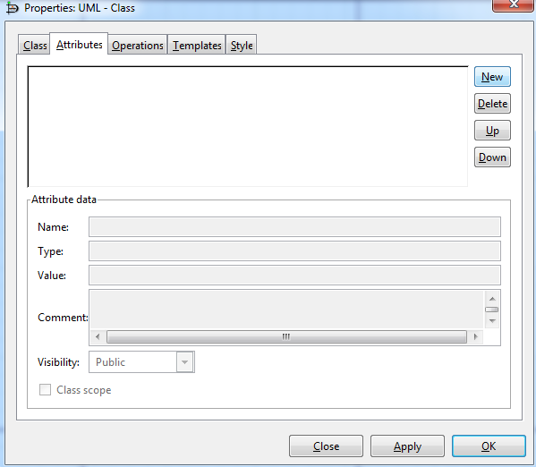
Now choose the Tabbed button “Attributes” to name the attribute

Slide 32
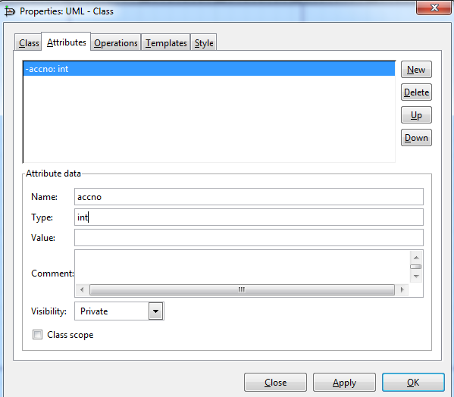
Press the button “New” to enable the “Attribute data” fields and edit the fields(name,type and visibility)

Slide 33
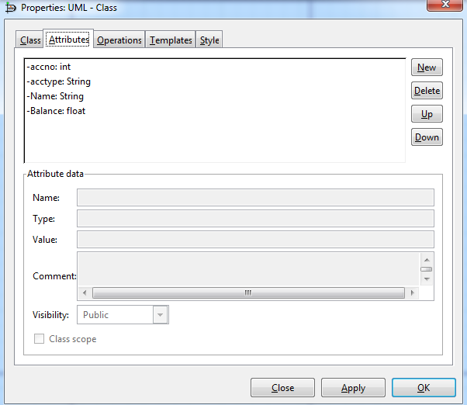
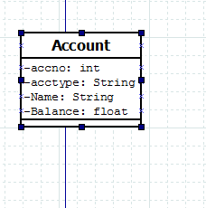
Now press the button “New” to add more attributes and finally press “ok”

Slide 34
Similarly, choose the Tabbed button “Operations” to add the operations
Press “New” to enable the parameter data fields

Slide 35
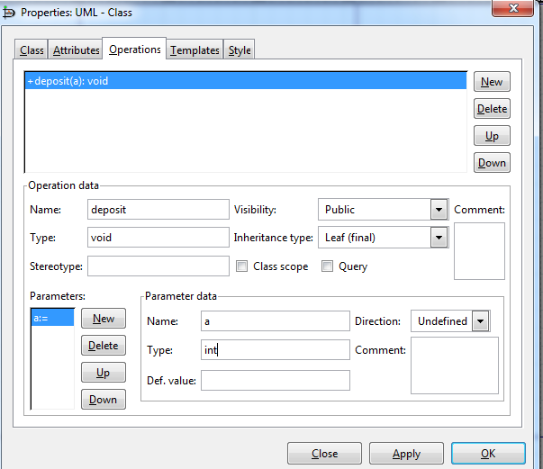
Adding parameters and type and press ok

Slide 36
Use the same procedure to add other methods

Slide 37
A sample showing the “Association” relationship
Double click the association link for setting the properties

Slide 38
A sample showing the generalization relationship

Slide 39
A sample showing the Aggregation

Slide 40
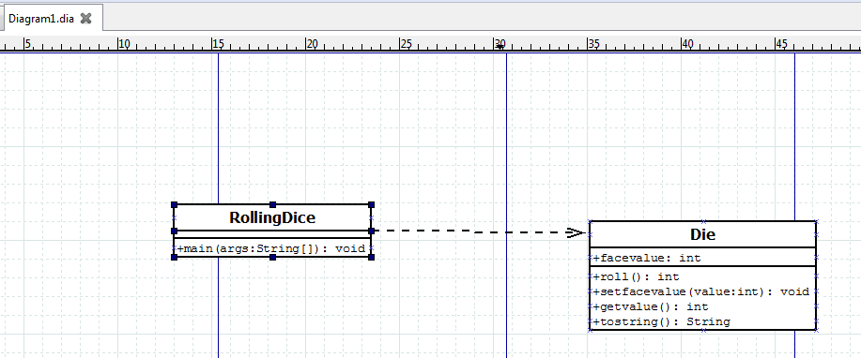
A sample using Dependency Relationship between the classes

Slide 41
Further References
https://www.youtube.com/watch?v=SXYjvLZblNo
http://dia-installer.de/doc/en/dia-manual.pdf

Slide 42
Case study-Railway Reservation System (Refer the file: Railwayreservation.dia)

Slide 43
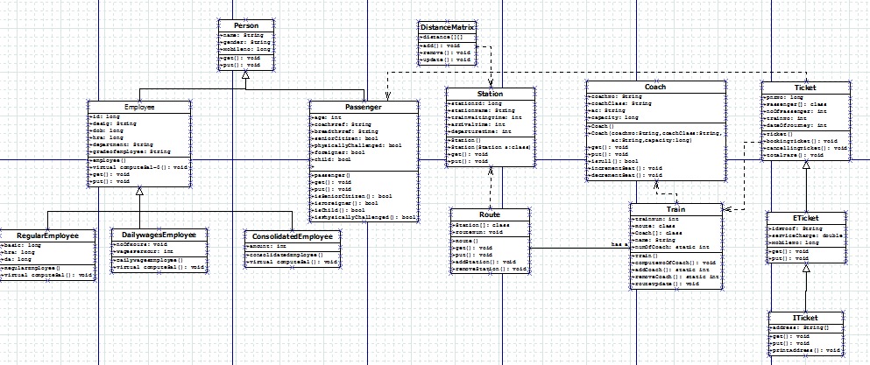
Class diagram-Railway reservation system

